Slide 1
Caltrans Clean California Local Grant Program
Glenn County Parks Accessibility and Beautification Project

Slide 2
Clean California Local Grant Program Overview
Provides approximately $296 million to beautify and improve roads, parks, pathways, transit centers etc.
Eligible applicants were local or regional public agencies, transit agencies and tribal governments.
More than half of the overall program funds will benefit or be located in underserved communities.
Maximum grant award is $5 million.
The local match component ranges from 0% to 50% of the project costs.
Projects were selected based on:
  Community need and public engagement in the project proposal that reflects community priorities.
  Potential to enhance and beautify public space.
  Potential greening to provide shade, use of native drought-tolerant plants and reduce the urban heat island effect.
  Potential to improve access to public space and the benefit to underserved communities.

Slide 3
Clean California Local Grant Program Award
The Clean California Local Grant was very competitive with a short timeline for application submittal.
Caltrans received 329 applications that sought $758,485,147 in grant funds.
105 projects, approximately 30% of applications were awarded, totaling $295,993,146 in requested grant funds.
Glenn County was awarded $4,480,790 with a 0% match requirement.
Each of the three projects awarded are located in underserved communities.
Project locations include:
  Willows Memorial Park- $1,820,214
  Orland Memorial Park- $2,165,376
  Walker Creek Park- $495,200

Slide 4
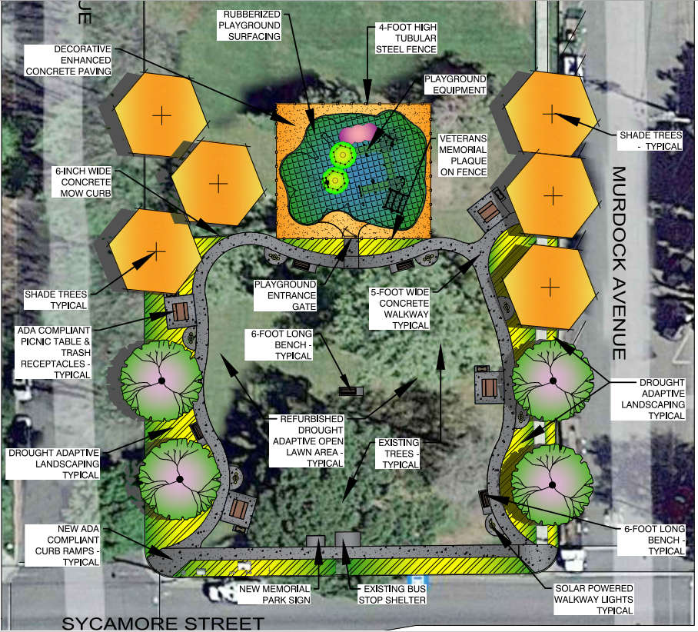
Willows Memorial Park Conceptual Design

Slide 5
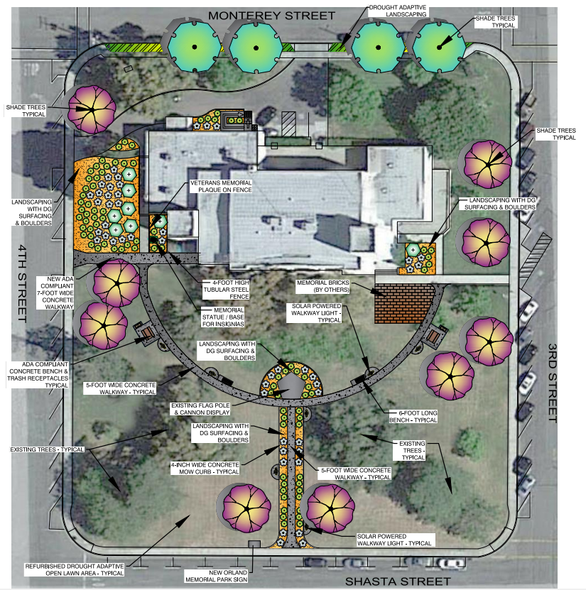
Orland Memorial Park Conceptual Design

Slide 6
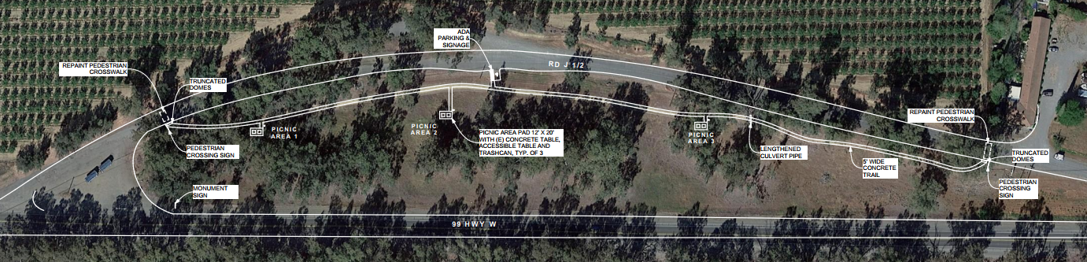
Walker Creek Park Conceptual Design

Slide 7
Clean California Local Grant Program Conclusion
Glenn County Facilities staff will manage the grant administration and project administration.
Architect/engineering services, construction services and labor compliance services will be contracted.
All projects must be completed and open to the public by June 30, 2024.
Grant must be closed out prior to December 31, 2024.
We are excited to have been awarded these Caltrans Clean California Local Grant Program funds and look forward to completing these projects to increase beautification, community pride and public health!

