Slide 1
Glenn County General Services Hamilton City Community Hall and Library ADA Upgrades
Funded by the Community Development Block Grant (Housing and Community Development)

Slide 2
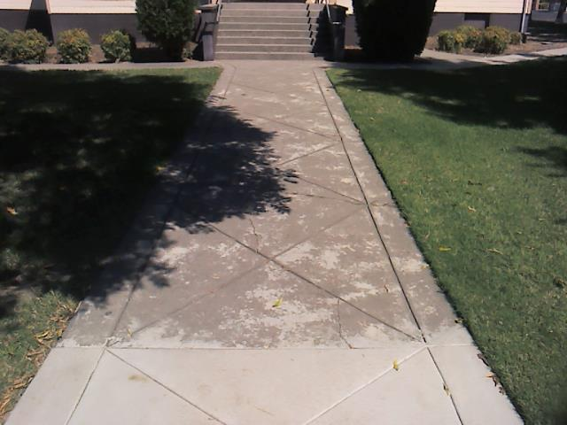
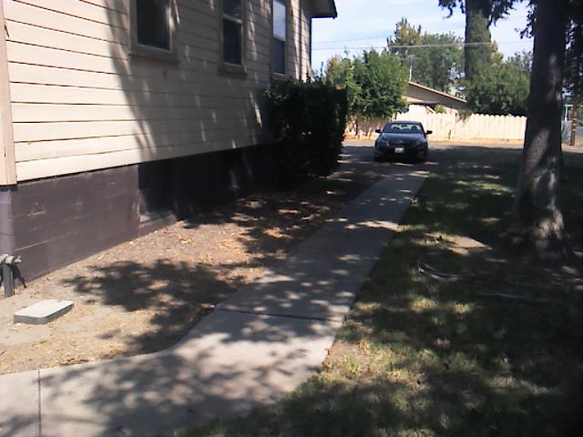
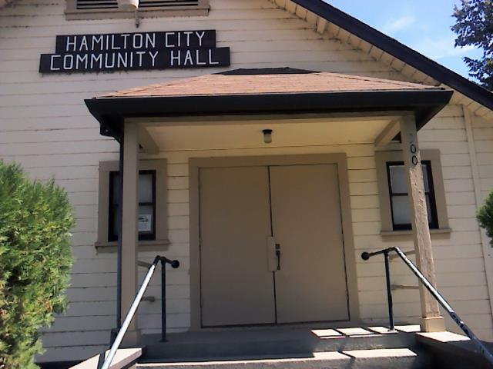
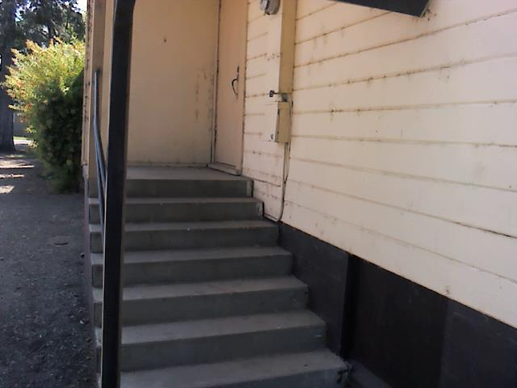
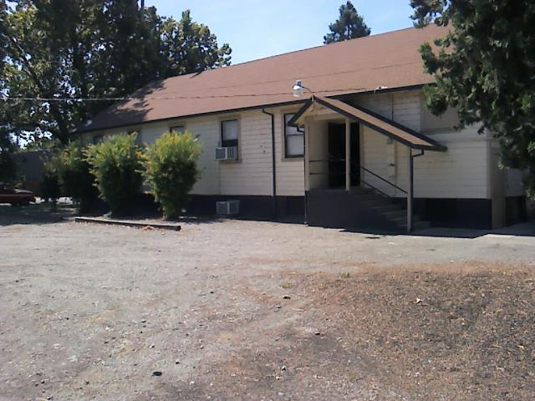
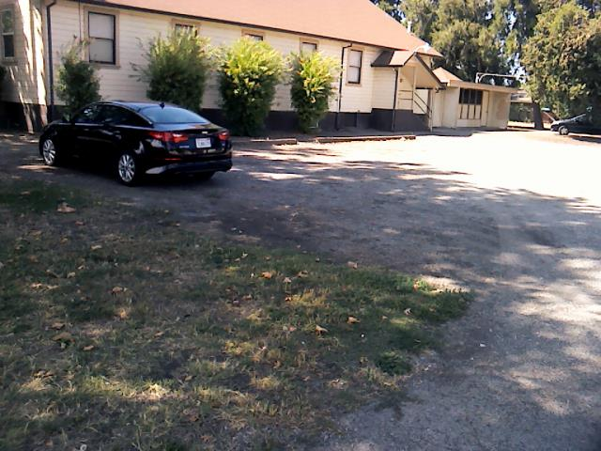
Community Hall Exterior- Before

Slide 3
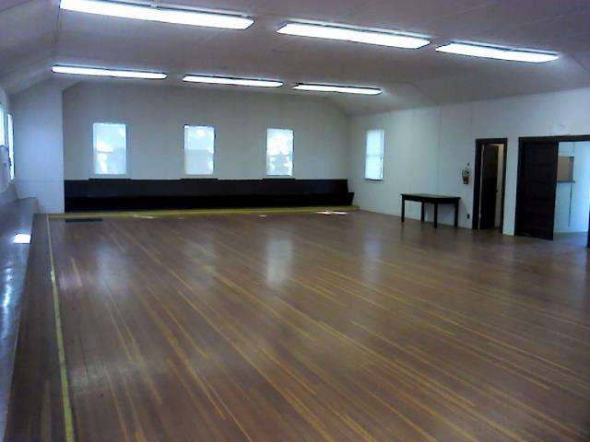
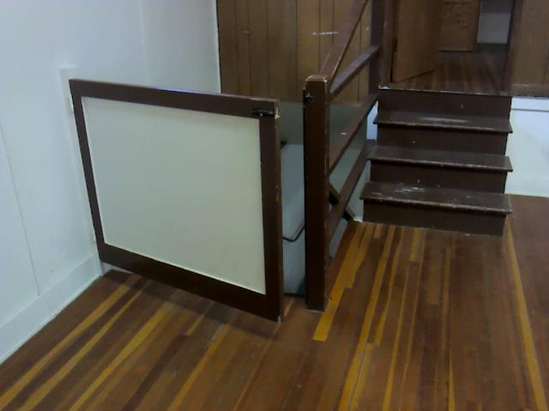
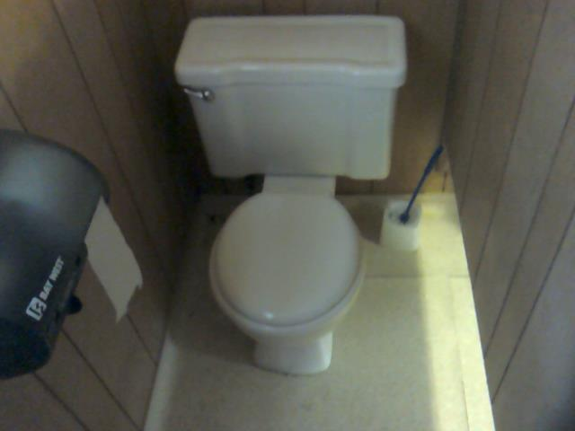
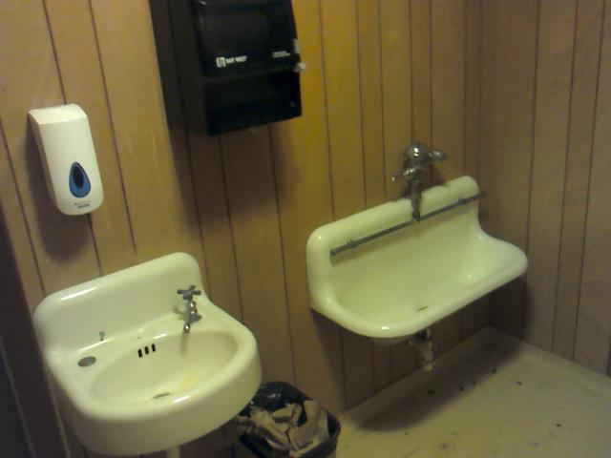
Community Hall Interior- Before

Slide 4
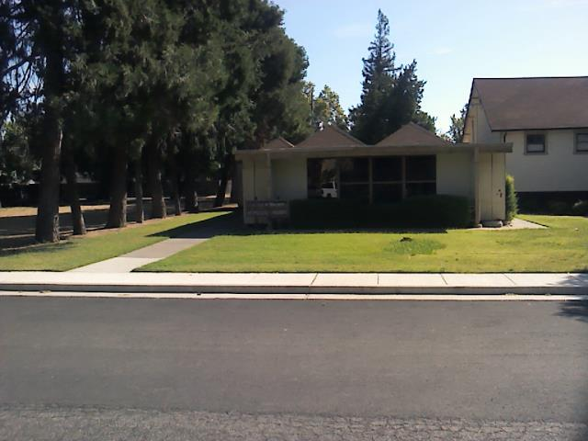
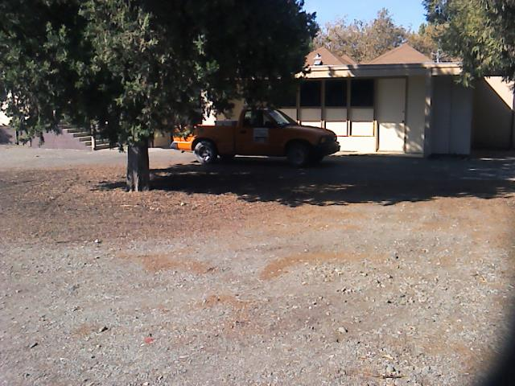
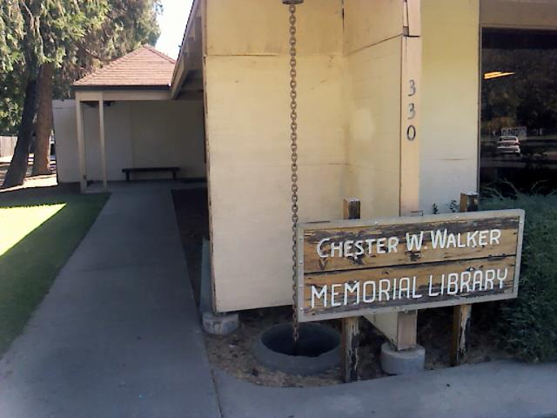
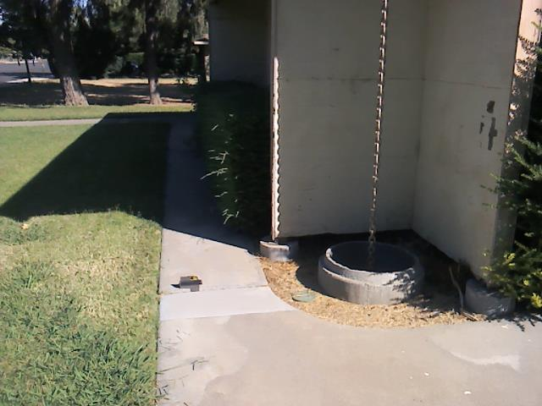
Chester Walker Memorial Library Exterior- Before

Slide 5
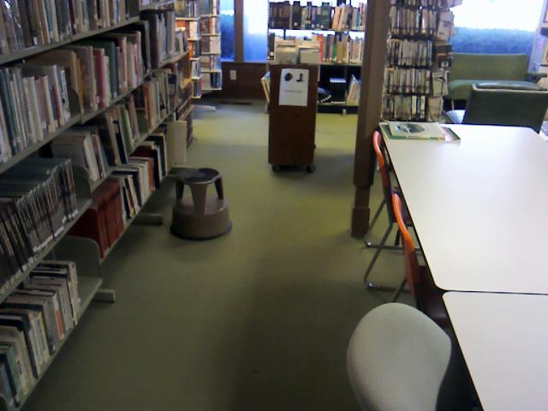
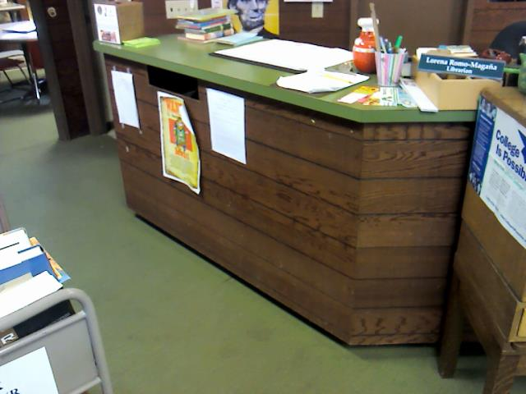
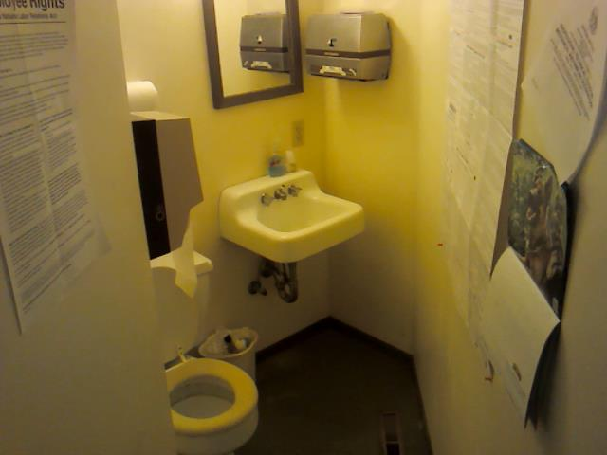
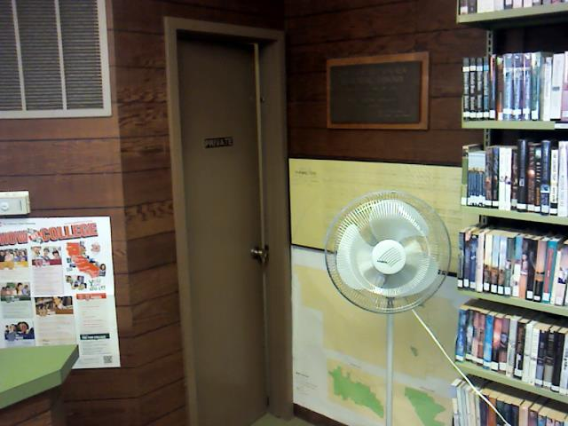
Chester Walker Memorial Library Interior- Before

Slide 6
Community Hall Front Entrance
Sidewalk to Stairs
Stairs and Railing

Slide 7
Community Hall South Ramp to Front Entrance
Sidewalk to Ramp
Ramp to Front Entrance

Slide 8
Community Hall East Ramp to Back Entrance
Front and Back Entrance Ramps
Back Entrance Ramp South Side

Slide 9
Community Hall East Ramp to Back Entrance
Back Entrance Ramp North Side
Back Entrance Ramp Door

Slide 10
Community Hall Kitchen and Drinking Fountains
Fridge, Range Oven and Sink
Drinking Fountains

Slide 11
Community Hall Restrooms
Exterior Main Level
Interior Main Level

Slide 12
Community Hall Restrooms
Exterior Stage
Interior Stage

Slide 13
Community Hall Wheel Chair Lift and Parking Lot
Chair Lift
ADA Parking

Slide 14
Library Front Entrance
New Landing and Door
Accessible Path from Sidewalk

Slide 15
Library Side Entrance
ADA Parking to Side Entrance
Accessible Path from Sidewalk

Slide 16
Library Carpet and Pathways
Main Library
Accessible Isles

Slide 17
Library Drinking Fountain and Counter
Fountains
ADA Counter

Slide 18
Library Restroom
Interior
Urinal

Slide 19
Library Parking
ADA Space
ADA Space

